Slide 1
Digital Mobile Radio (DMR) BASICS
OBRA TRAINING
OBRA WEB SITE
https://obraobx.com/

Slide 2
What Will Be Covered
What is DMR
DMR Structure and Features
Getting Started
Radio Programming Basics
DMR Calls (Demo)

Slide 3

DMR Can Be Confusing
Color Codes
Receive Groups
Contacts
Two Slot TDMA
Channels
RADIO ID
Talk Groups
Zones
Talk Groups
DMR- MARC
Brandmeister
Code Plugs
C Bridge
Hot Spots

Slide 4
WHAT IS DMR
DMR was developed by the European Telecommunications Standards Institute (ETSI) and is used world wide by both professional and amateur users.
Three Tiers:
  Tier 1: Single Channel (Unlicensed, 446Mz, Low Power)
  Tier 2: Two Slot. Developed to replace conventional analog commercial radio systems (Used By Amateurs)
  Tier 3: Two Slot Trunking (Shared Channels)

Slide 5
WHAT IS DIGITAL
Digital means that your voice is represented by a steam of binary numbers instead of a varying voltage.
Services that have gone digital: Telephone, Cable TV, Broadcast TV, Cell Phones
Advantages:
  More Reliable
  Uses Less Bandwidth
  Noise Free Quality Audio
  Other information can ride along

Slide 6
Analog vs DMR Repeater Channel
Analog Channel
Xmit. Frequency
Rec. Frequency
PL Tone
DMR Channel
Xmit. Frequency
Rec. Frequency
Time Slot
Color Code (Like PL Tone)
Talk Group
DMR ID (Assigned to Radio)

Slide 7


DMR Repeater Structure
Repeater Operation
Channel
-Xmit. Frequency
-Rec. Frequency
-Time Slot
-Color Code
-Talk Group
-DMR ID
INTERNET
PRN Network (MARC)
Brandmeister Network
Bridge Point
TS 1, TG 91
Bridge Point
TS 2, TG 82
TS 2, TG 82
TS 1, TG 91

Slide 8
DMR Repeater Structure
Repeater Operation
TS 1, TG 91
Channel
-Xmit. Frequency
-Rec. Frequency
-Time Slot
-Color Code
-Talk Group
-DMR ID
TS 2, TG 82
TS 1, TG 91
INTERNET
PRN Network
Brandmeister Network
TS 2, TG 82
Bridgr Point
Bridge Point
Bridge Point
TS 2, TG 82
TS 1, TG 91
TS 1, TG 91
TS 2, TG 82

Slide 9
DMR Repeater Structure
Repeater Operation
TS 1, TG 91
Channel
-Xmit. Frequency
-Rec. Frequency
-Time Slot
-Color Code
-Talk Group
-DMR ID
TS 2, TG 82
TS 1, TG 91
INTERNET
PRN Network
Brandmeister Network
TS 2, TG 82
Bridgr Point
Bridge Point
Bridge Point
TS 2, TG 82
TS 1, TG 91
TS 1, TG 91
HOT SPOT
TS 2, TG 82

Slide 10
Brandmeister vs PRN
PRN
Repeater Defines Available Talk Groups
OBRA Repeaters Have 6 Assigned
  1 – Local (Repeaters Only)
  2 - PRN
  3 - Chat 1
  4 - Chat 2
  5 - Echo Test
  6 - Disconnect
Brandmeister
Any Brandmeister TG Can Be Used
There 1,688 as of 4/14/2-23
Examples
91 International
92 Europe
93 North America
31377 Outer Banks
3167 Blind Hams
9990 Parrott

Slide 12
DMR SIMPLEX
- Same Transmit & Receive Frequency
Talk Group 99
Time Slot 1

Slide 13
Getting Started
Get a DMR ID
  https://www.radioid.net/register
Get a Radio
  OBRA Has Loaners Available (Jim Bailey)
  Radioddity GD-77 ~$100
  TYT MD-380 ~$100
  Baofeng DM-1701, Retevis RT3S ~$100
  Baofeng DR-1801 ~$100
  Radioddity GD-88 ~200
  AnyTone AT-D878UVII Plus ~$300
  AnyTone AT-D578UVIII Plus (Mobile)~$450
Get a Code Plug (Radio Programming SW)
  Get one from OBRA Member
  Write one yourself (lots of internet info available)

Slide 14
What is a Code Plug
A Digital File used to Program a DMR Radio
Created using Radio Specific Software (CPS)
Contains
  Your User ID and Call Sign
  Channels/Frequencies/Offsets/Color Codes
  Talk Groups (Contacts)
  Zones (Group of Channels)
Demo of Code Plug

Slide 15
OBRA andDMR
DMR Net – 1st and 3rd Tuesday on TG 31377
PRN Local TG Used For Some Event Communications.

Slide 16
Using a DMR Radio
Select a Zone
Select a Channel/Talk Group in that Zone
PTT to setup connection (Times out in 15 Min.)
KW4ZL Monitoring
K4JAR, KW4ZL

Slide 17
DMR DEMO
Echo Test (Parrott) Call
Talk Group 31377 Call
Talk Group 91 Call
Hot Spot Call

Slide 18
BACKUP DATA

Slide 19
DMR Terms
Time Slots
Time slots allow two conversations on the same repeater
Each time slot occupies the signal for less than 30ms at a time. Within a 60ms window on a repeater: time slot 1 is transmitted for 27.5ms, then a gap of 2.5ms, time slot 2 is transmitted for 27.5ms, another 2.5ms gap, and then repeats with time slot 1

Slide 20
How Does DMR Work
Binary Numbers
Decimal
Base 10
00
01
02
03
04
05
06
07
08
09
10
11
12
13
14
15
0000
0001
0010
0011
0100
0101
0110
0111
1000
1001
1010
1011
1100
1101
1110
1111
Binary
Base2

Slide 21
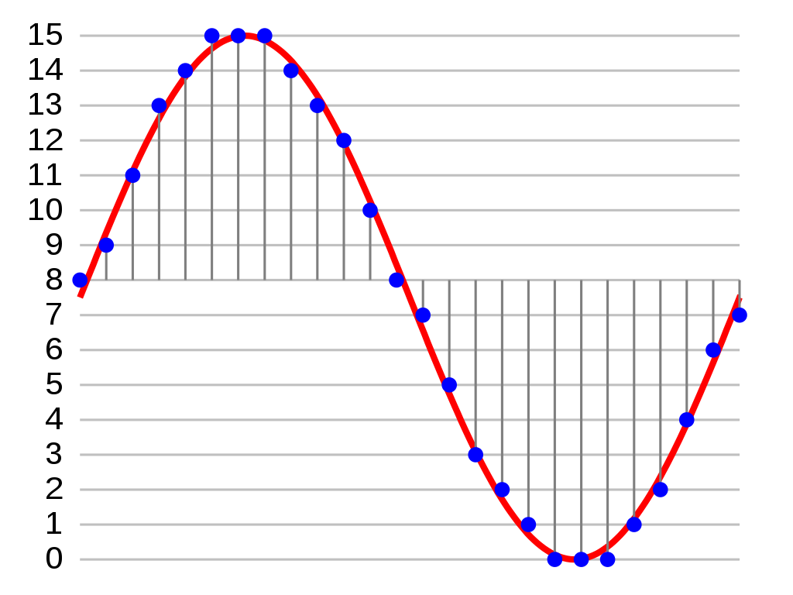
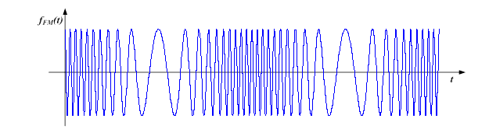
How Does DMR Work
Digital Encoding/Modulation
. . . . . .
8 9 10 11 12 13 14 15 - - - - - - - >
|1000|1001|1010|1011|1100|1101|1110|1111| - - - - - - >
Modulation
FSK, QAM, Etc.
100010011010 - - - >

