Slide 1
OBRA Education Series http://www.obraobx.com
Introduction to
Ham Radio and OBRA

Slide 2
What Will Be Covered
Ham Radio Overview
VHF/UHF Radios
Linked Repeaters and their Use
OBRA Net
OBRA Events
Introduction to DMR (Digital Mobile Radio)
Radios and Programing
  Examples of various radios will be available
  Demos of radio use and operation

Slide 3
Ham Radio History
Government licensing of radio stations and amateur operators began with The Radio Act of 1912.
  Amateurs were assigned wave lengths < 200 meters
Since radio waves transcend national boundaries The International Telecommunications Union (ITU) was formed in 1865 to define frequency bands and their use.
In the United States the FCC is responsible for the wire and radio communications and allocates frequency bands to the various services, including amateurs, in accordance with ITU Plan.
Today amateurs have many bands allocated to them.

Slide 4
Ham Radio Overview
There are 2 major segments. HF and VHF/UHF
  HF uses 160 meter through 10 meter bands
  HF is mostly base stations with large antennas and bounces signals off the ionosphere. (another class)
VHF/UHF (this class)
  VHF/UHF uses 2 meter and 70 centimeter bands
  Hand Held, mobile and base station low power radios (limited range)
  Uses repeaters to increase range
  Analog and Digital modes

Slide 5
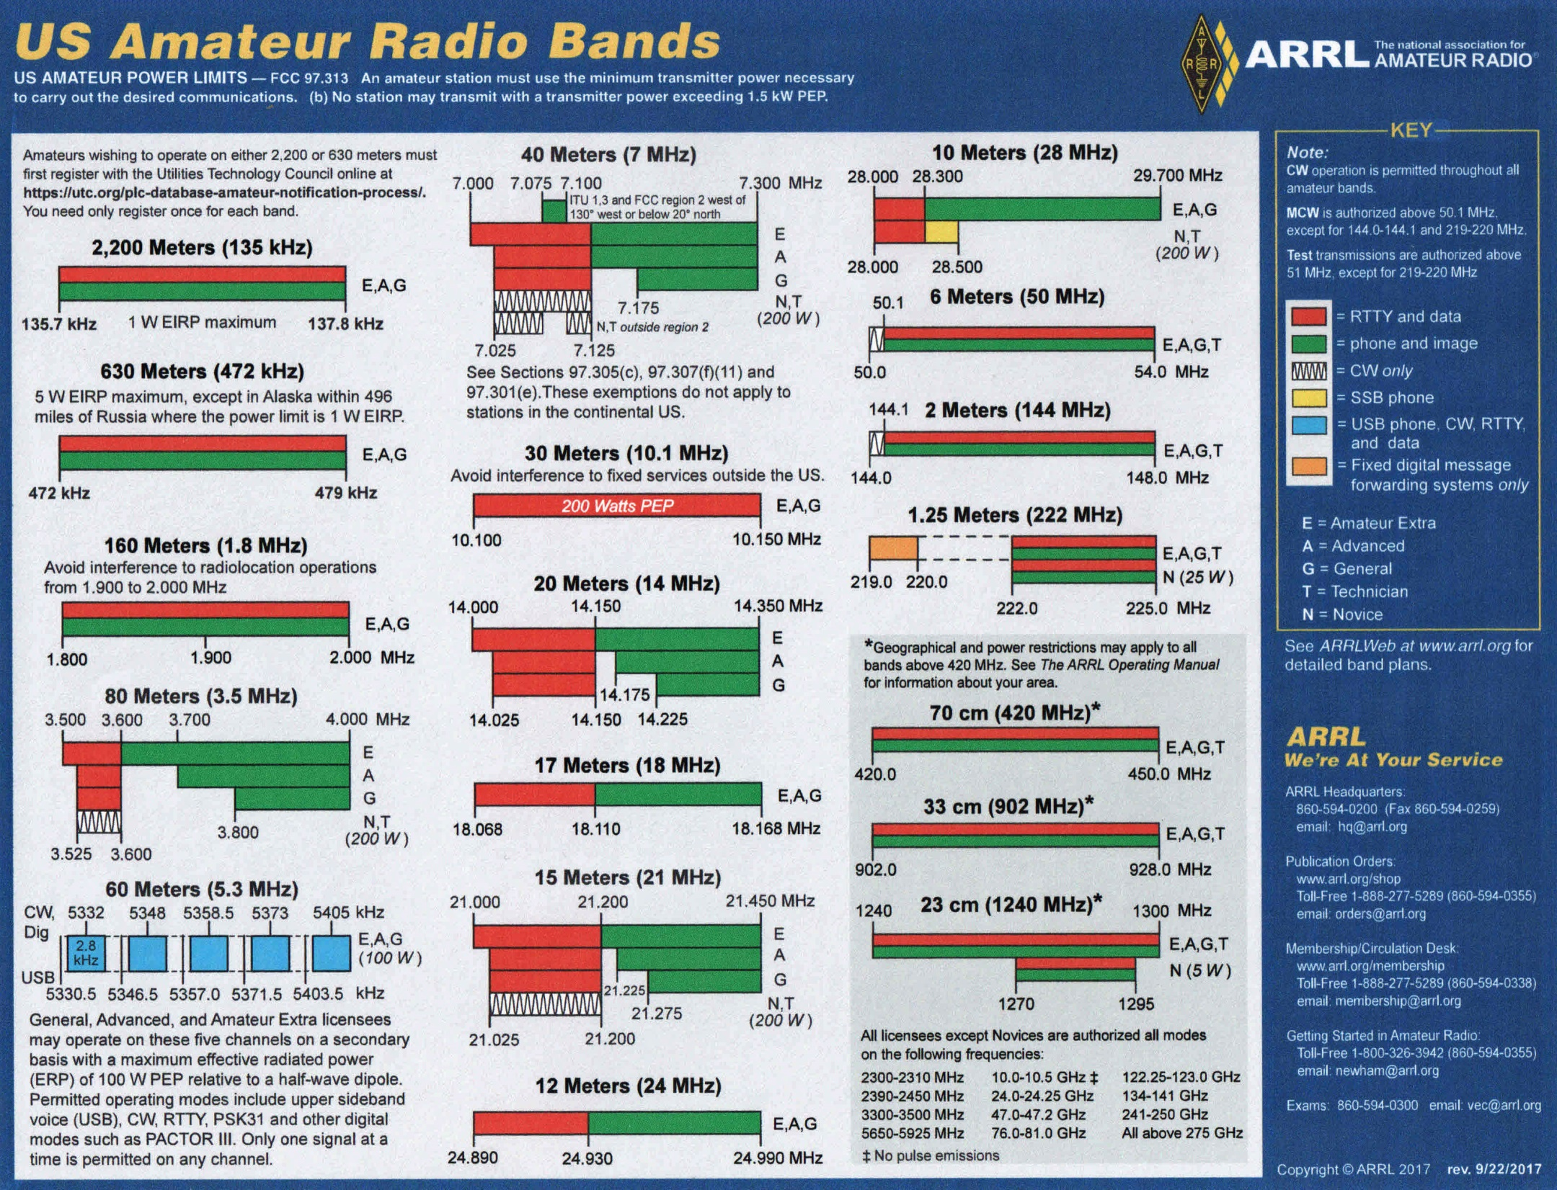
HF = 1.6Mhz-30Mhz
VHF
UHF

Slide 6
Hand Held Radios
Simplex Operation (Half Duplex)
Each radio transmits and receives on the same frequency.
At any time one transmits and one receives.
Example
146.490 MHz
2 Meter (VHF)
144.1 MHz – 148.0 MHz
70 Centimeter (UHF)
420.0 MHz – 450.0 MHz

Slide 7
Radio Protocol
To announce yourself:
  Say your call sign followed by “monitoring”
To call another station:
  Say the stations call sign followed by yours.
Repeat your call sign every 10 min. and at the end of your transmission.
Example
  KW4ZL Monitoring
  N4ACT KW4ZL
  KW4ZL Clear

Slide 8
Repeaters
A & B can talk, but A & B can’t talk to C.
C can’t talk to A or B.
Distance or Obstacles
Prevents Communications
B
C
A

Slide 9

Repeaters
Adding a repeater solves the problem and greatly improves the available range.
B
Repeater
- High elevation provides line of sight
for clearance above obstacles.
- Antenna is larger for better reception.
- Higher transmit power for greater range.
C
A

Slide 10
Repeaters
Repeaters needs to use frequency offsets.
B receives on
145.150 MHz
C receives on
145.150 MHz
B
Repeater receives on 144.550 MHz
and retransmits on 145.150 MHz
(offset of -600KHZ)
C
A transmits on
144.550 MHz
Repeater can’t transmit and receive on the same
frequency since the transmit signal would block
the receive signal.
A

Slide 11
Repeaters
Repeaters Also Need a PL Tone.
C receives on
145.150 MHz
B receives on
145.150 MHz
(PL 131.8 Hz)
(PL 131.8 Hz)
B
Repeater receives on 144.550 MHz
and retransmits on 145.150 MHz
(offset of -600KHZ)
C
A transmits on
144.550 MHz
The PL/CTCSS tone is needed to access the repeater. This prevents spurious signals from activating the repeater.
A
(PL 131.8 Hz)

Slide 12
OBRA Linked Repeaters
Mamie
Waves
444.3325 MHz
146.940 MHz
Mamie DMR
Buxton
147.060 MHz
145.150 MHz
Columbia
442.725MHz
Echolink
K4OBX-L
Hatteras
444.725 MHZ
Nags Head
145.290 MHz
Kill Devil Hill
145.110 MHz
Ocracoke
442.225 MHZ

Slide 13
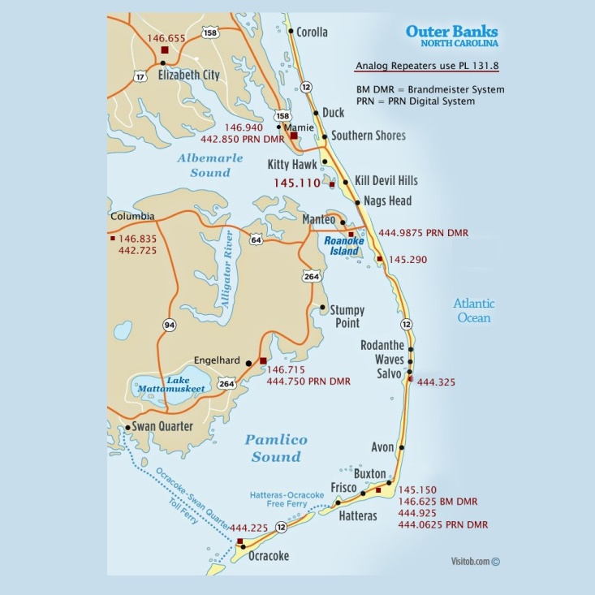
OBRA Repeaters

Slide 14


OBRA Linked Repeaters
EchoLink Details
To other linked Repeaters
Columba
442.725 MHz
Smart Phone or PC
Running EchoLink App.
Connected to K4OBX-L
||||
….
442.725
PC Running EchoLink App.
Designated K4OBX-L

Slide 15
OBRA Linked Repeaters
Thursday Night Net
The purpose of the net is to promote fellowship among the amateur radio operators of the Outer Banks and to help us develop our communication skills. It provides us with an opportunity to test our equipment that may be used during an emergency event. Check-ins from all amateurs are welcome and encouraged.

Slide 16
OBRA Net Procedures
(Accessed from any OBRA repeater or Echolink)
Net control announces net will start at 8:00PM (7:55 PM Thursdays)
Starts the net, introduces him/herself (8:00 PM)
Asks for emergency traffic or announcements
Calls for stations to Check In (South to North)
Stations respond with
  Net control call sign, their call sign, name, location and desire to be “in-and-out” or stick around.
Net control logs stations and checks for any check-ins missed
Then opens informal discussion for those who stuck around
Net Control closes the net
NOTE: A script covering the net procedure is available

Slide 17
OBRA Event Procedures
One Ham is event control:
  Coordinates with event organizers to provide logistics and safety support
  Assigns time and location information to ham participants
  Provide event specific activities requiring monitoring
  Usually provides APRS info with a follow vehicle which can be viewed on a smart phone

Slide 18
OBRA Event Procedures
Ham participants:
  Arrive on station at time assigned
  Check in with event control
  Advise control when event activities occur
  Stay on station until released by event control

Slide 19
OBRA Event Procedures
Event communications procedures:
  Standard call signs:
    N4ACT, KW4ZL is on site at 158 and 3rd street
    KW4ZL, N4ACT acknowledges.
  Tactical call signs:
    Use of letter sequences to indicate locations of event stations
    Race Control this is OBRA 5, KW4ZL on site
    After last transmission sign off with your call sign

Slide 20
OBRA Event Procedures ( continued)
Event communications procedures:
  Emergency Situation
    Break, Break, Race Control this is OBRA 5, I need an EMS unit at 158 and 3rd Street for BIB # 34 who is down and injured.
      All other stations stay off the air until race control finishes with the emergency.

Slide 21


DMR Basic Structure
Simplex Operation
Time Slot 1
Time Slot 2
INTERNET
- Frequency
-ID Number
-Time Slot
DMR-MARC Network
Or
BrandMeister Network
Repeater Operation
Channel
Channel
- Frequency/Offset
- Color Code
- Talk Group
-Time Slot
Zone
- Group of Channels
Talk Group
- Digital transmission is more efficient
and provides noise free reception.
- Two time slots allow two radios to use a
repeater at the same time.
- Internet connectivity and talk groups allow contacts
to be directed to specific groups of participants.

Slide 22
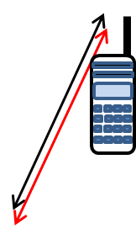
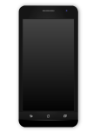
DMR Basic Structure
With Hot Spot
Simplex Operation
Time Slot 1
Time Slot 2
INTERNET
- Frequency
-ID Number
-Time Slot
DMR-MARC Network
Or
BrandMeister Network
Repeater Operation
Channel
Channel
- Frequency/Offset
- Color Code
- Talk Group
- Time Slot
Zone
- Group of Channels
Talk Group
or
Hot Spot
Cell Phone
A Hot Spot (Access Point) can
also used to access a DMR network.

Slide 23
VHF/UHF Radios
Types of Radios Available
  Analog FM 2 meter/70 cm
    Baofeng UV-5R $50
    Baofeng FB-F8HP $70
  Analog/Digital 2 meter/70 cm
    Baofeng 1801 $100
    BTECH DMR-6X2 Pro $300
  Analog/Digital 2 meter/70 cm with GPS/APRS
    Anytone 878 UVII $315
    GD 88 $215

Slide 24

Setting Up Your Radio
(Plenty of help available from club members)
For each channel
  Simplex = Frequency
  Repeater = Frequency, Offset, PL Tone
Can be done from radio key pad (hard) or from a PC program (preferred)
Programming
Cable

